Slide 1


Slide 2
THE GENESIS

Slide 3
PROBLEM BACKGROUND
There are three major areas of concern, which are;
Safety
Accessibility
Affordability

Slide 4

PROBLEM BACKGROUND

Slide 5
PROBLEM BACKGROUND
Safety
Accessibility
Affordability

Slide 6
PROBLEM BACKGROUND
F(x) = y
➔ F(Accessibility) = Affordability.
No matter how cheap the rides are, people won’t use the ride if there are excessive time delays.

Slide 7

The waiting is always the hardest part. -Tom Petty and the Heartbreakers.

Slide 8
PROBLEM BACKGROUND
The 2017 Arise Study found that almost two-thirds of customers said they would wait two minutes or less and 13% said that no wait time is acceptable.

Slide 9
PROBLEM BACKGROUND
ACCESSIBILITY

Slide 10
PROBLEM BACKGROUND
Here we’ll look at this pain point from 3 different views of groups affected;
The Customer’s Point of View.
The Champion’s Point of View.
The Company’s Point of View.

Slide 11
The Customer’s Point of View.
“I only had to wait three minutes to be connected to a 'Champion'. Unfortunately, this champion was at least 20 minutes away from me. I tried Max later in the day and it was pretty much the same story. Both attempts required 20-30 minutes wait times. Absolutely no one wants to wait that long to find an Okada."
– a Max.ng User.

Slide 12
PROBLEM BACKGROUND
According to a 2014 American Express survey, the maximum amount of time customers are willing to wait is 13 minutes.

Slide 13


Slide 14
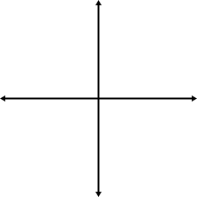
The Champion’s Point of View.

Slide 15
The Champion’s Point of View.

Slide 16
The Company’s Point of View.
When customers experience time delays on a consistent basis, they get unhappy.
When customers get unhappy, they seek for better alternatives (The grass is greener on the other side, right?)
For a company to have a high customer retention rate, the customers (and the champions) have to be happy. At (almost) all times.

Slide 17
What Happens if this Pain Point Persists?

Slide 18
THE MESSIAH

Slide 19
The Solution

Slide 20
OUR IDEA
What if there is a way, if there is a sort of magic that can always tell our Champions where to go?

Slide 22
What is HotUsers?
HotUsers is a recommendation system that predicts the closest hotzones to a Champion’s current location.
Hotzones are locations with a high concentration of population that are in need of transportation.

Slide 23
What is HotUsers?
By being close to areas where customers are located, Champions help reduce the waiting time of clients, leading to higher consumer happiness and less number of trips being cancelled.

Slide 24
What is HotUsers?
And being close and visible to potential customers translates to a higher service usage from customers (both old and new).
Higher service usage of the platform translates to more profit for the company.

Slide 25
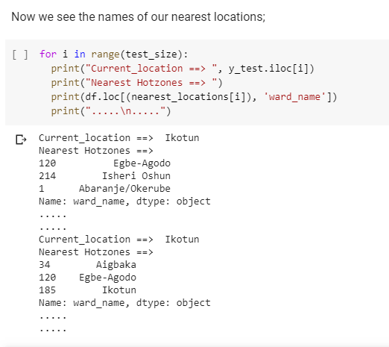
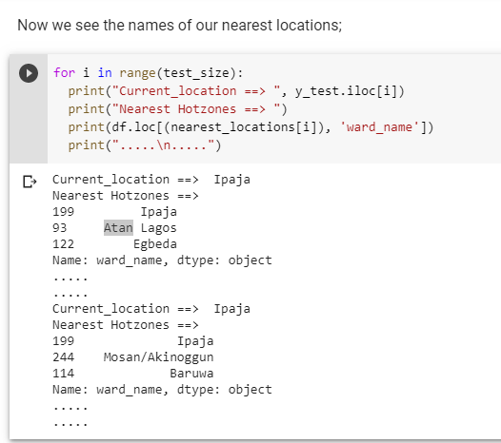
PROTOTYPE DEMO

Slide 26

THE LOGIC BEHIND IT

Slide 27

OUR DATASETS

Slide 28

OUR ALGORITHM

Slide 29
OUR PROCESS
To see the source code, check out this link:
https://bit.ly/hotusers

Slide 30
How Can HotUsers be Improved Better?
HotUsers is based on Content-based filtering approach.
Content-based filtering methods are based on a description of the item and a profile of the user's preferences. These methods are best suited to situations where there is known data on a location (name, coordinates, attributes etc.), but not on the users.

Slide 31
How Can HotUsers be Improved Better?
We wish to make HotUsers a Hybrid Recommendation system, by combining our Content-based filtering approach with a Collaborative-based recommendation system (This is based on the assumption that people who agreed in the past will agree in the future, and it, generates recommendations using only information about the profiles and usage history of the different users).

Slide 32
Summary
HotUsers works in real time and has the ability to learn further using geographical data collated from clients during rush hours.
HotUsers will give Max.ng a boost and also help in increasing customers’ happiness and satisfaction through prompt and swift responses.

Slide 33
THANK YOU
FOR LISTENING

